Slide 1




Navigation
Product
SAP Business Suite 7.0
Level
Beginner
Focus
SAP ERP 6.0 EhP4
Abstract
On completion of the course, students will be able to navigate through the user interface to deal with business processes and case studies.

Slide 2
Content
User guidance
User specific settings
Navigation in SAP Easy Access Menu
Help

Slide 3
Learning Targets
At the end of this chapter you can
name the window elements,
navigate in an SAP system,
apply personal system settings,
effectively use help.

Slide 4
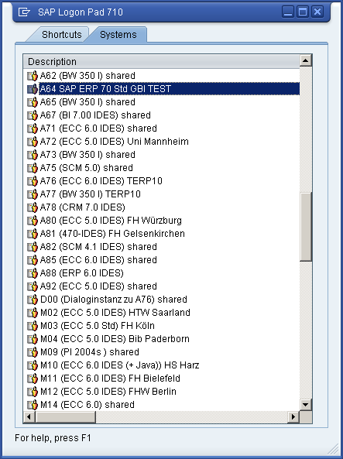
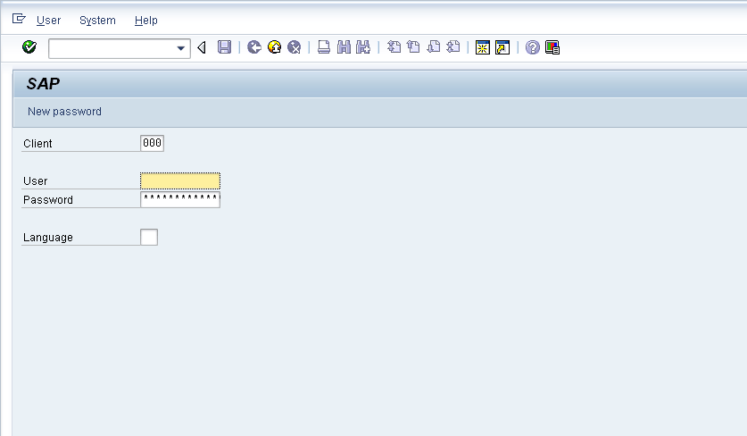
Log on to an SAP system

Slide 5
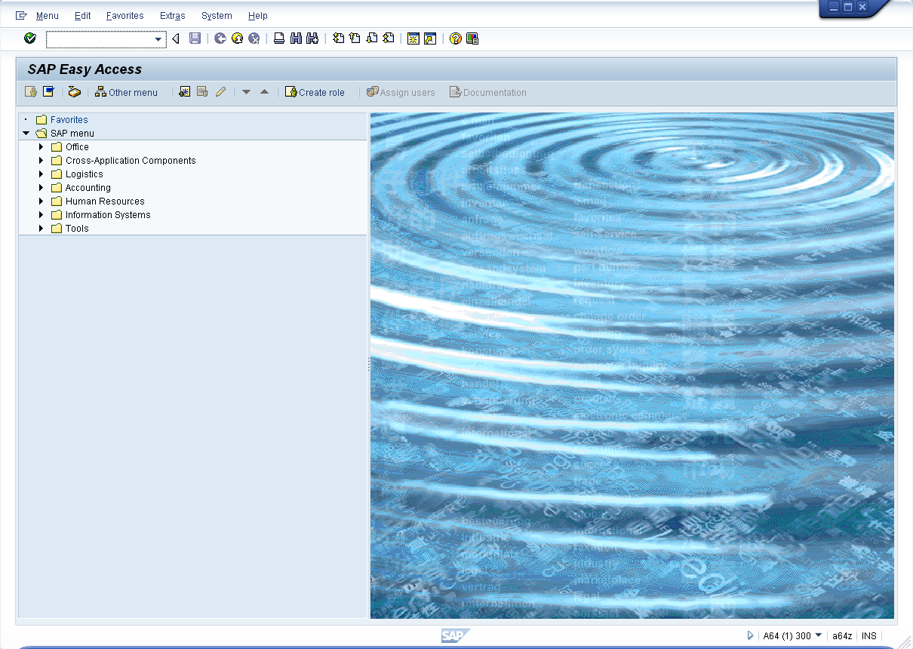
SAP Easy Access Menu

Slide 6
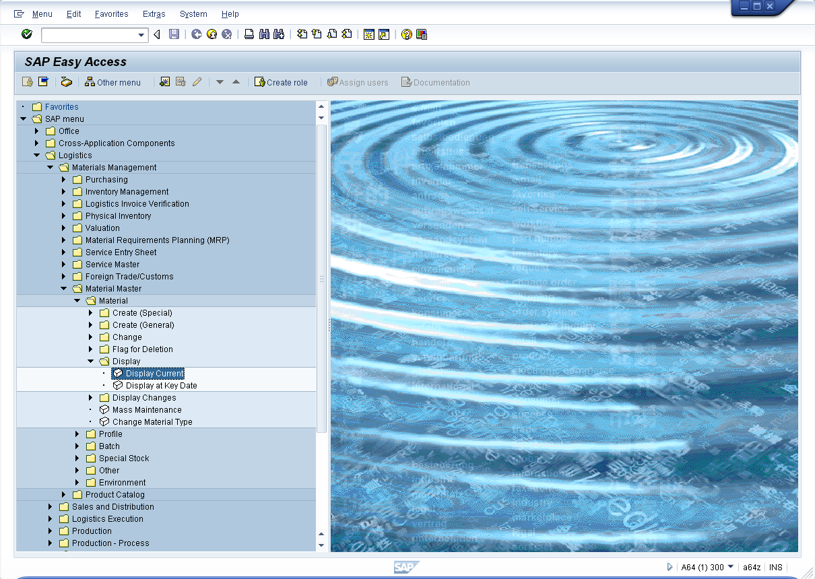
SAP Easy Access Menu

Slide 7
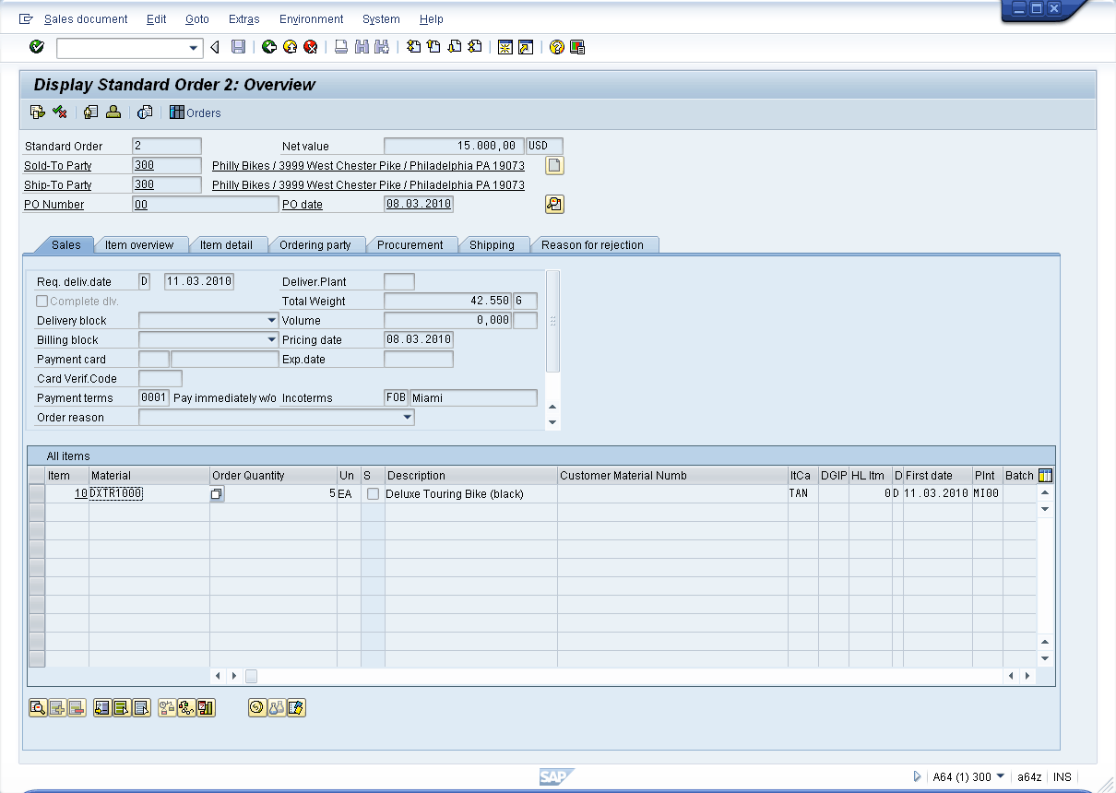
GUI Design
Header data
Position overview
Position details

Slide 8
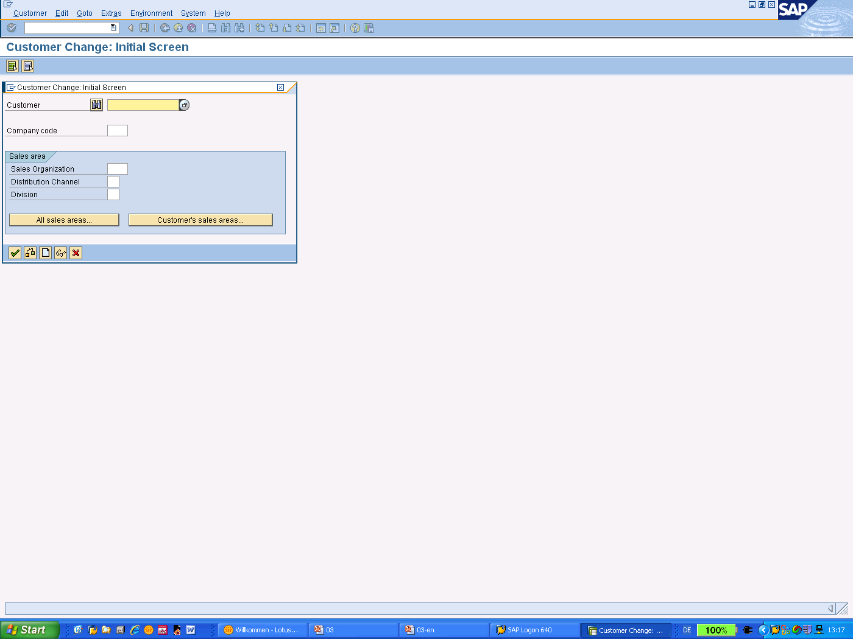
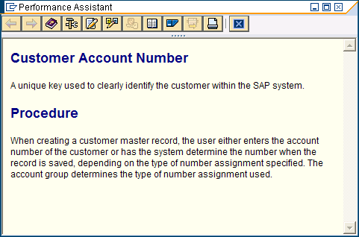
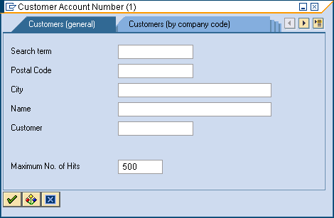
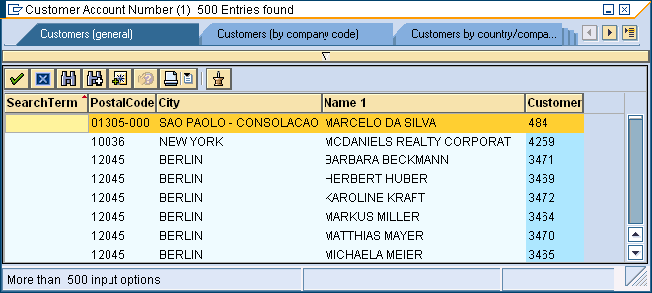
Help Functions
F1: Description of input fields
F4: Value list

Slide 9
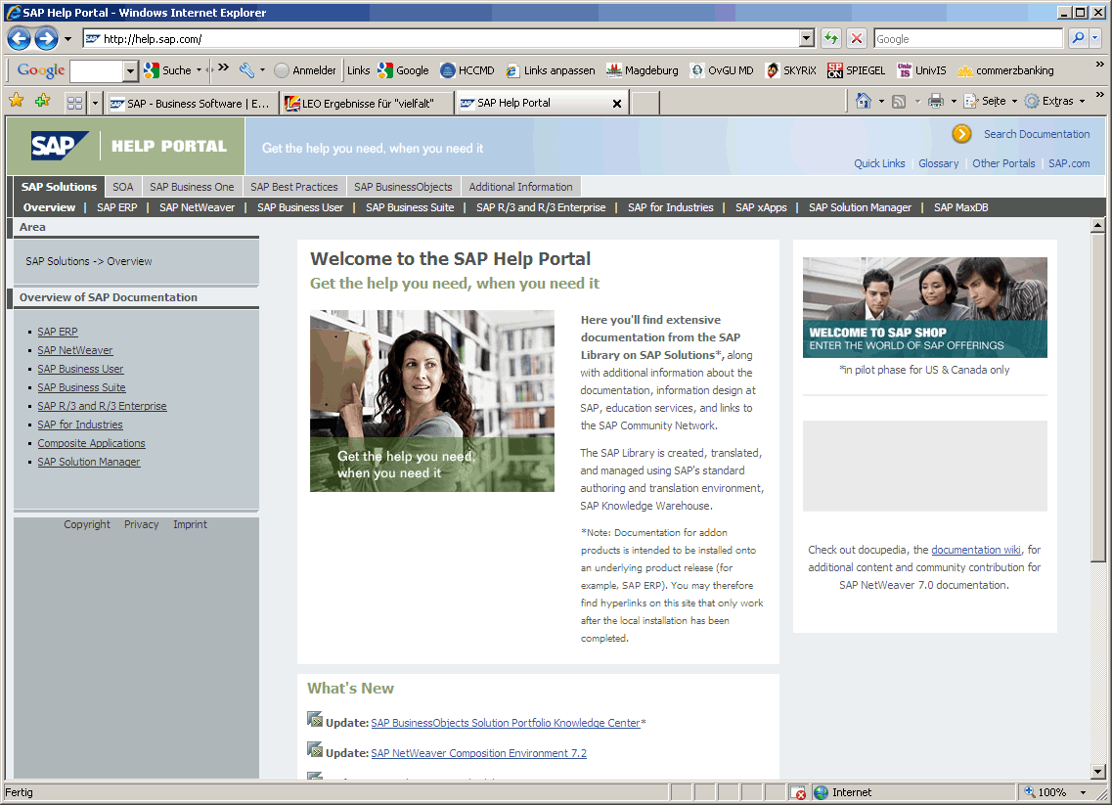
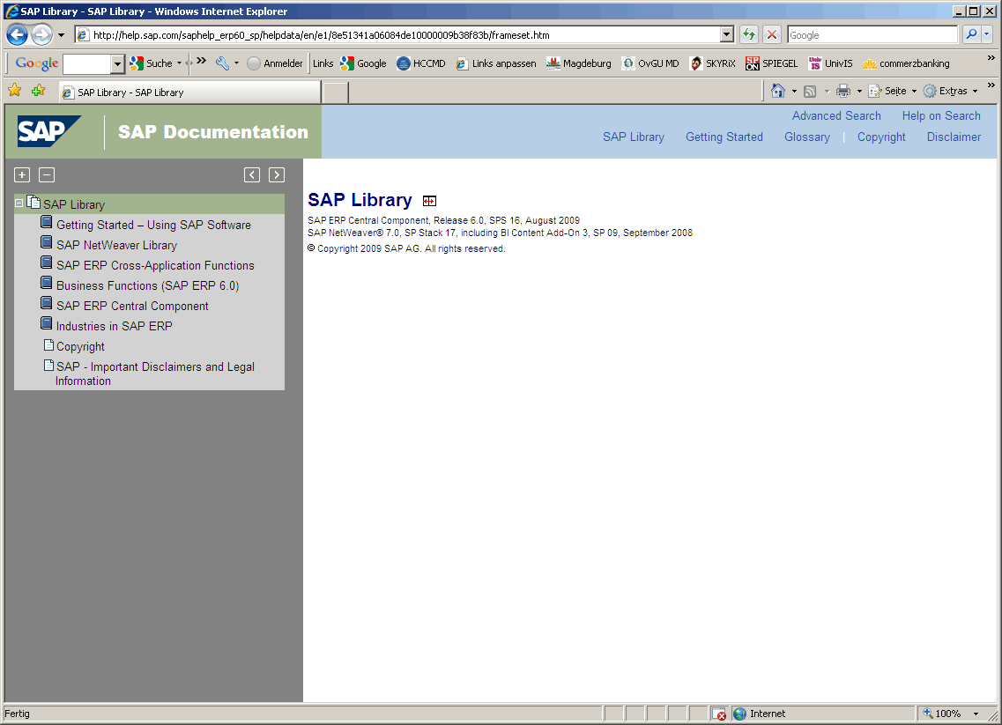
SAP Help Portal
http://help.sap.com

Slide 10
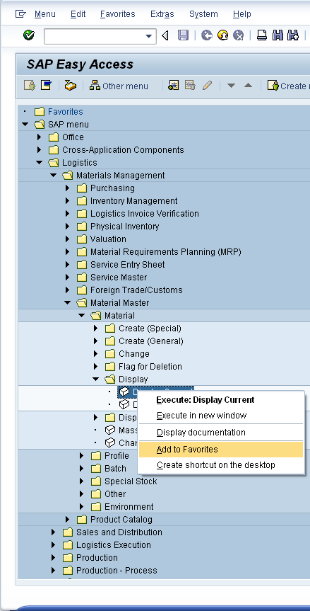
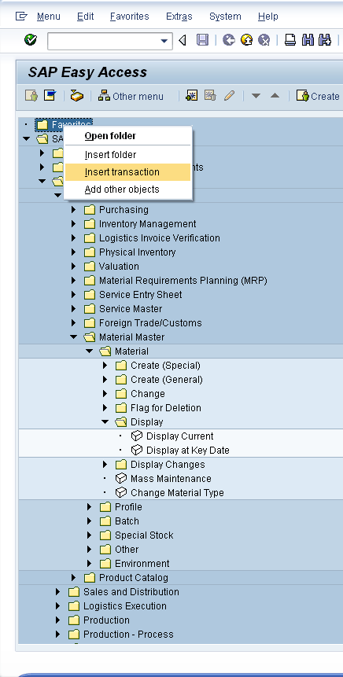
Favorites

Slide 11
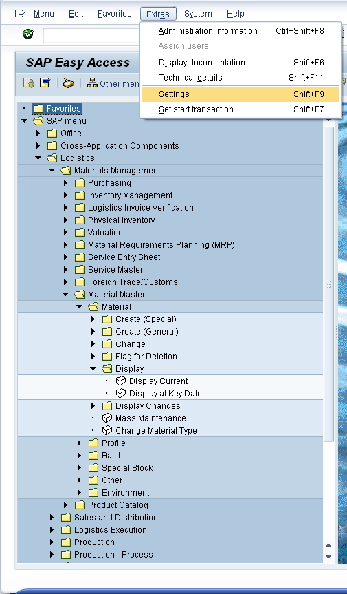
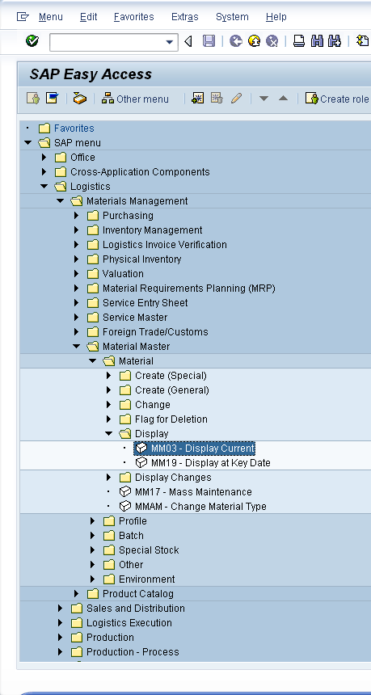
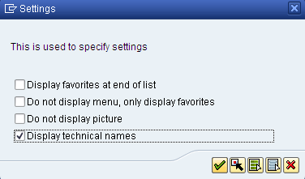
Transaction Codes

Slide 12
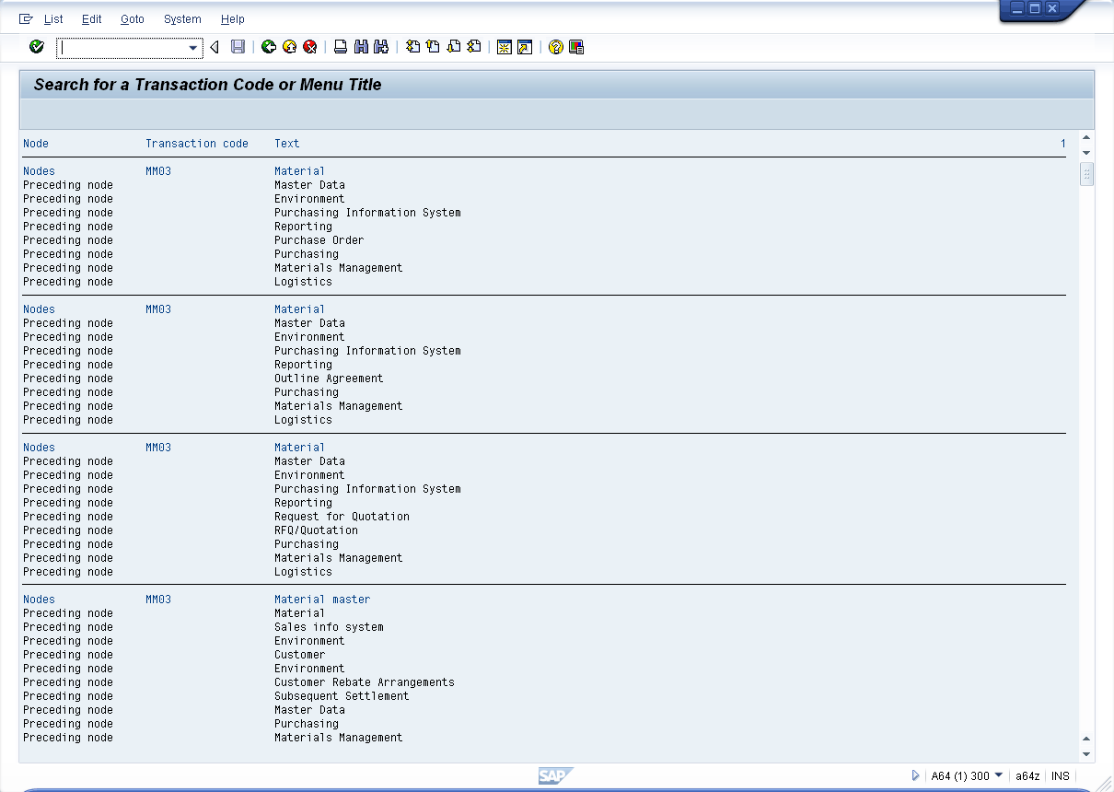
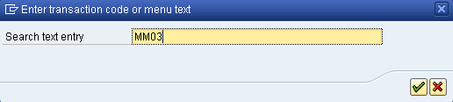
Transaction SEARCH_SAP_MENU

Slide 13
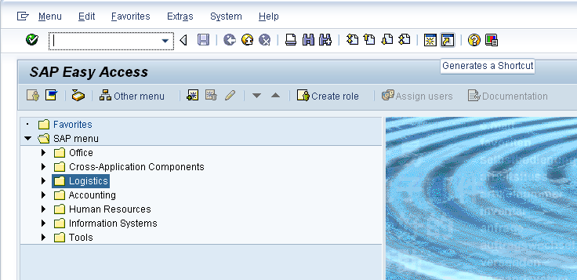
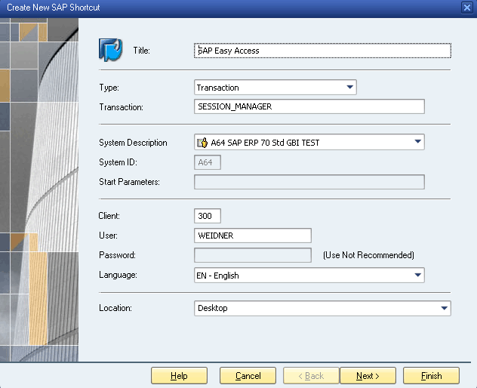
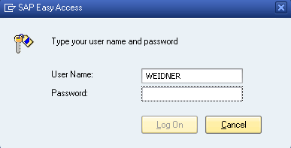
Desktop Shortcut

Slide 14
Summary
You are now able to:
  name the window elements,
  navigate in an SAP system,
  effectively use help.

